Slide 1
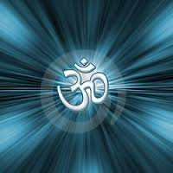
AUM YOGA STUDIO

